Slide 1
Agile TEST PROCESS
Version 5.7
11/02/2017

Slide 2
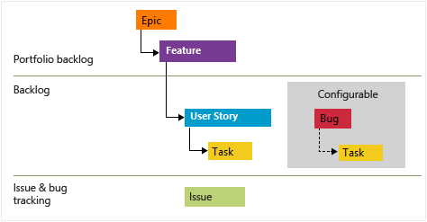
Requirements
Level | Relationship | Example
EPIC | 1 to many Features | Get a Quote
Features | 1 to many User Stories | Billing
User Story | 1 to many Test Scenarios | Payments
Test Scenarios | 1 to many Test Cases | CC, 1X, Check
Test Case | Sequential Flow Steps | Positive, Negative, Boundary

Slide 3
Basic Terminology – Test Artifacts
Portfolio Test Strategy (DirectNet)
Project Test Approach (if required)
Sprint 1 Test Approach
Sprint 2 Test Approach
Sprint 3 Test Approach
Test Scenario
Test Scenario
Test Scenario
Test Case
Test Case
Test Case
Test Case
Test Case
Test Case
Test Scenario
Test Scenario
Test Scenario
Test Case
Test Case
Test Case
Test Case
Test Case
Test Case
Level | Test Artifact | Purpose
Portfolio (How) | Portfolio Test Strategy (1 per Area) | Documents test strategy for each component of a system Architecture and Tools GUI Services Database Regression testing End to End test case Performance and security test Test data conditioning and storage methods Bug Reporting and Triage
Project (Why, When, Where) | Project Test Approach derived from Test Strategy (e.g. Policy API) | Document following testing approach for each component impacted by project Test types and timelines Test environments Regression test plan (dynamic selected from regression suite based on function risk and coverage requirements) Performance and security test plan (derived from test approach) End to End tests (derived form test approach based on code coverage for user stories in sprint) Best practices
Sprint (What) | Sprint Test Approach | Evolves with sprint maturity. It contains: Functional tests (As requirements mature from User Stories tests are identified and automated) Test Data Requirements

Slide 4
PROJECT KICK-OFF
Sprint Planning Meeting
Smoke Test Creation
Functional Test Creation
Automated Build & Deployment Step 2 (Functional Test)
Automated Build & Deployment Step 3 (Regression Test)
Regression & Smoke Test Optimization
Automated Build & Deployment Step 1 (Smoke Test)
Sprint Retrospective

Slide 5
Project Phase Goal: Create Project Plan & Test Approach
Metrics:
Onsite/Offshore Ratio
Kick Off Meeting
Product Backlog Identification and prioritization
Input
1. Identify Key Stakeholders for Project Planning
2. Definition of Project Goal
3. Project Plan
4. Portfolio Test Strategy
Resource Planning
Prepare Application Test Approach
Define Sprint Time Lines
Include Developers / Leads / Managers as needed
Review with Analysts / Dev / PO
Scrum Team Identification & Feature Assignment
Application Test Approach Sign Off
Output
1. Signed off Application Test Approach
2. Backlog identified
Product Owner / Scrum Master
Scrum Team Activity
Test Team Activity

Slide 6
Sprint planning meeting Goal: Determine what will be done in Sprint and align test approach
Input :
Sprint Backlog defined in TFS
All US requirements are documented in TFS
US Walkthrough meeting completed within scrum team at the end of prior Sprint
Application Test Approach
Metrics:
V1 - Onsite/Offshore Ratio
P9 - CPET
Review Sprint User Stories for Acceptance Criteria
Acceptance Criteria finalized and laid out in User Story
Analyze Test Data Requirements
Assign Story Points to User Stories
Create TFS tasks
Assign Stack Ranking to all US
Complete Sprint Estimates
Select Test Approach
Analyst Activity
Review with Analysts / PO / SM
Output:
Acceptance Criteria Finalized for all User Stories
Story Points & Stack Ranking Completed for all US within Sprint
Sprint timelines and testing schedule
Sprint Test Approach
Scrum Team Activity
Analyst & Tester Activity
Sign off Sprint Test Approach
Tester Activity
Product Owner / Scrum Master

Slide 7
Smoke test Creation
Goal: Smoke Test Case designed, scripted, signed-off and integrated in CI solution
Update Test Based On Feedback
No
Metrics:
P3 - Test Design Productivity
P4 - Test Automation Productivity
A1 - TC Automation Percentage
Input
1. Test Data Identified
2. Application URL/Endpoint
3. Test Environments
4. Access to all project specific environments / Servers are in place
5. Critical Acceptance Criteria/Functionalities from US
6. List of all connection points
Smoke Test Scenarios Documented
Walkthrough Smoke Test Scenarios with TRB*
Test Scenarios Approved
*TRB = Test Review Board
Yes
No
Update Test Based On Feedback
Sign Off On Test Scenarios
Future capabilities:
**Implement the usage of Enterprise Test Data Management solution to support Test Data Management
Sign Off On Test Cases
Test Case Approved
Walkthrough Test Cases with Analysts
Create Smoke Test Cases & Generate Required Test Data
Yes
Design
No
Scripting
Update Test Based On Feedback
Smoke Test Scripts (STS) Automated
Execute Dry-run of STS
Dry-run
Test Result Review with Analysts
Dry-run Test Result Approved
Sign Off on Dry-run of Test Script & Close Design Review Task
Hand off Automated Smoke Test to DevOps
Yes
Output
Automated Smoke Test integrated in DevOps CI solution.
List of Smoke Test Candidates signed off by Analysts
Smoke Test Pass
Email Smoke Test results to Stakeholders
Smoke Test execution in CI Solution
Code is checked in to Build & Deployed to QA Environment
Add Smoke Test to CI Solution Framework
Analyze Test Failures
Report Bug
Bug Fix
Tester Activity
Analyst Activity
TRB Activity
DevOps Activity
Analyst & Tester Activity

Slide 8
Smoke test Creation (DirectNet)
Input
1. Test Data Identified
2. Application URL/Endpoint
3. Test Environments
4. Access to all project specific environments / Servers are in place
5. Critical Acceptance Criteria/Functionalities from US
Smoke Test Scenarios Documented
Create Smoke Test Cases & Generate Required Test Data
Smoke Test Scripts (STS) Automated
Smoke Test execution in CI Solution
Code is checked in to Build & Deployed to QA Environment
Hand off Automated Smoke Test to DevOps
Execute Dry-run of STS
Email Smoke Test results to Stakeholders
No
Smoke Test Pass
Analyze Test Failures
Report Bug
Bug Fix
Yes
Sprint Functional Testing starts
Output
Smoke Test executed within CI solution.
Smoke Test executed after every build deployment to every environment.
Published Test Results
Tester Activity
Analyst Activity
TRB Activity
DevOps Activity
Analyst & Tester Activity

Slide 9
FUNCTIONAL test creation
Goal: Functional Test Case designed, scripted and signed off for all User Stories.
Metrics:
P3 - Test Design Productivity
P4 - Test Automation Productivity
P6 - % of Automated User Stories
Update Test Based On Feedback
No
Input
1. User Stories
2. Acceptance Criteria
3. Test Approach
4. Test Data Identified
5. TFS Design Tasks
Test Scenarios Documented
Walkthrough Test Scenarios with Analysts
Test Scenarios Approved
Near term automation capabilities:
* Selected Regression Candidate serves as input to TRB Meeting.
** Automatic link between Requirements in TFS and TCs in ALM
Yes
Sign Off On Test Scenarios
No
Update Test Based On Feedback
RTM Initiated
Sign Off On Test Cases
Yes
Test Case Approved
1. Walkthrough Test Cases with Analysts
2. Select Regression Candidates *
Create Smoke Test Cases & Generate Required Test Data
RTM completed **
Design
Scripting
Update Test Based On Feedback
No
Review Successful
Output
1. RTM
2. Test Scripts automated
3. List of Regression Candidates
Test Scripts Automated
Peer Review of Test Scripts
Close Test Design Tasks
Yes
Tester Activity
Analyst Activity
Analyst & Tester Activity

Slide 10
Automated Build & Deployment Step 1 (SMOKE Test)
Goal: Deploy code, execute Smoke Test and report result to stakeholders
Near term automation capabilities:
* Future enhancement will be a roll back feature on smoke test failure
** Functional test cases will be automatically selected and triggered after Smoke Testing is complete.
Metrics:
TE1 - Test Execution Cycle Time
TE2 - Test Execution Productivity
P5 - Invalid defects
Input
1. Automated Smoke Test signed off by Analysts
2. Automated Smoke Test Integrated in CI solution
Bug Fix
Report Bug
Smoke Test Execution in CI Solution
Smoke Test Pass*
Analyze Test Failure
Code is Checked-in to Build
Build Deployed to next environment
Email Smoke Test Result to Stakeholders
No
Output
Smoke Test executed within CI solution.
Smoke Test executed after every build deployment to every environment.
Published Test Results
Yes
Sprint Functional Testing Starts**
Automated Activity
Tester
Dev Activity
DevOps Team

Slide 11
Automated Build & Deployment STEP 2 (Functional TEST)
Goal: Complete execution of functional test cases, document and report test results.
Metrics:
P1 - Test Execution Cycle Time
P2 - Test Execution Productivity
A1 - TC Automation Percentage
P5 - Invalid defects
Q1-Q5 - Defect Slippage
Q6 - Test Coverage
Sprint Functional Testing Starts
Bug Fix
**Report Bug
Input
1. Successful Smoke Test
2. Resolved User Stories
3. Automated Functional Test Scripts
Execute Sprint Functional Test*
Publish Test Results to Scrum Team*
Test Pass
No
Analyze Test Failure
Yes
Near term automation capabilities:
*Implement solution to automatically select , execute targeted functional test and publish results
** Regression test cases will be automatically selected and triggered after Functional Testing is complete.
Output
1. Published Test Results
2. TFS Tasks Closed
3. User Story Closed
Sprint Regression Testing Starts
**Refer Bug Reporting & Triaging Slide for Bug Life Cycle Details
Tester Activity
Dev Activity

Slide 12
Automated Build & Deployment Step 3 (regression Test)
Goal: Complete execution of Regression test cases, document and report test results.
Metrics:
P1 - Test Execution Cycle Time
P2 - Test Execution Productivity
A1 - TC Automation Percentage
P5 - Invalid defects
P10 - EPET
Q1-Q5 - Defect Slippage
Q6 - Test Coverage
Q7 - Defect Density
Sprint Regression Testing Starts
Bug Fix
**Report Bug
Input
1. Successful Smoke Test
2. Successful Functional Test
3. Resolved User Stories
4. Optimized Regression Test Bed from prior Sprint
Execute Sprint Regression Test*
Publish Test Results to Scrum Team*
Test Pass
No
Analyze Test Failure
Yes
Output
1. Published Test Results
2. Regression TFS Task Closed
Near term automation capabilities:
* Implement solution to automatically select , execute targeted Regression test and publish results
**Refer Bug Reporting & Triaging Slide for Bug Life Cycle Details
Tester Activity
Dev Activity

Slide 13
Regression & smoke test optimization
Goal: Determine and maintain optimized Regression & Smoke Test suites.
Metrics:
P9 - CPET
Automation Team automates the approved Regression/Smoke Test Suite
Review Obsolete\Redundant Cases in current regression suite to achieve optimization
Input
1. List of Regression Candidates identified by Tester/Analyst during Functional Sprint Testing
2. List of Smoke Test Candidates signed-off by Analysts
3. Review Board Members
Regression/ Smoke Test Approved
Add /Update Regression/Smoke Test Suite
Walkthrough Regression & Smoke Test Case Candidates by Test Review Board
Yes
No
Update test based on feedback
Output
Regression Suite updated and automated.
Smoke Test Suite updated and automated
Analysts\Dev Leads\Test Leads
Test Team Activity

Slide 14
Sprint Retrospective Goal: Analyze sprint performance and adopt lessons learnt in Next Sprint
Metrics:
Velocity
P9 - CPET
P10 - EPET
P11 - Analyst Time Distribution
Q7 - Defect Density
Q1- Q5 - Defect Slippage
Q6 - Test Coverage
A1 - Test Automation Percentage
Input:
1.Story Points Planned vs Achieved in prior sprint
2. Hours Estimated/Burnt
3. Test Design/Execution Metrics
4. Bugs Reported vs Resolved
5. Sprint Velocity
Document what went well during Sprint Cycle
Document what went wrong during Sprint Cycle
Scrum Master/Product owner /Analysts /Testers/Developers Inputs
Document what we could do differently to improve
Output:
1. Sprint Retrospective MOM prepared to adopt Lessons Learnt and track mentioned input parameters for comparison
Team Activity
The retrospective is a collaborative process among all members, including the team, the product owner, and the Scrum Master.
The Scrum Master prioritizes actions and lessons learned based on team direction.
The retrospective supports team formation and bonding, particularly as many areas of conflict can be identified and dealt with.
The retrospective helps build the team's sense of ownership and its self-management.

Slide 15
Sprint Timelines & Activities
Release N
Sprint 1
Sprint 2
Sprint 3
Early Defect detection
Reduced Cost of Fixing Defects
Support daily builds
Reduced cost of QA delivery
Adherence to planned schedules and budgets
W1
W2
W3
W1
W2
W3
W1
W2
W3
S1 Development
S2 Development
S3 Development
❑
❑
❑
❑
❑
❑
❑
❑
❑
❑
❑
❑
S1 TESTING
S2 TESTING
S3 TESTING
ET
ET
ET
S1 Fix & Retest
S2 Fix & Retest
S3 Fix & Retest
RTB
RTB + S1
RTB + S1 + S2
❑
❑
❑
❑
❑
❑
❑
❑
❑
❑
❑
❑
Complete acceptance criteria
Complete non acceptance criteria
Optimize test cases
Automate test cases
Complete acceptance criteria
Complete non acceptance criteria
Optimize test cases
Automate test cases
Continuous Regression
DAILY REGRESSION (FUTURE ENHANCEMENT)
DEVELOPMENT FOR SPRINT
❑
EXPLORATORY TESTING
❑
CONTINUOUS AUTOMATED SMOKE (CI) AFTER EVERY BUILD
FUNCTIONAL TESTING
INTEGRATION & REGRESSION TESTING
SPRINT BUG FIX & RETEST

Slide 16
Functional Testing in Sprint
Sprint
W1
W2
W3
Early Defect detection
Reduced Cost of Fixing Defects
Support daily builds
Reduced cost of QA delivery
Adherence to planned schedules and budgets
Development
Development
Development
❑
❑
❑
❑
❑
❑
❑
❑
❑
❑
❑
❑
TEST DESIGN & REVIEW
FUNCTIONAL TESTING
ET
Bug Fix & Retest
Integration & Regression
❑
❑
❑
Complete Test design and Review
Identify Regression cases
Complete acceptance criteria
Complete non acceptance criteria
Optimize test cases
Automate test cases
WEEKLY MINI REGRESSION
DEVELOPMENT FOR SPRINIT
❑
EXPLORATORY TESTING
❑
CONTINUOUS AUTOMATED SMOKE (CI) AFTER EVERY BUILD
FUNCTIONAL TESTING
INTEGRATION & REGRESSION TESTING
TEST DESIGN & REVIEW
SPRINT BUG FIX & RETEST

Slide 17
Regression Testing in Sprint
Sprint
W1
W2
W3
Early Defect detection
Reduced Cost of Fixing Defects
Support daily builds
Reduced cost of QA delivery
Adherence to planned schedules and budgets
Development
Development
Development
❑
❑
❑
❑
❑
❑
❑
❑
❑
❑
❑
❑
Identify regression candidates
Identify regression candidates
Identify regression candidates
Bug Fix & Retest
Full Regression
❑
❑
❑
Identify Mini Regression cases
Identify Full Regression cases
Optimize Regression test cases
Automate newly identified test cases
WEEKLY MINI REGRESSION
DEVELOPMENT FOR SPRINT
❑
IDENTIFY REGRESSION CANDIDATES
❑
CONTINUOUS AUTOMATED SMOKE (CI) AFTER EVERY BUILD
FULL REGRESSION TESTING
SPRINT BUG FIX & RETEST

Slide 18
appendix

Slide 19
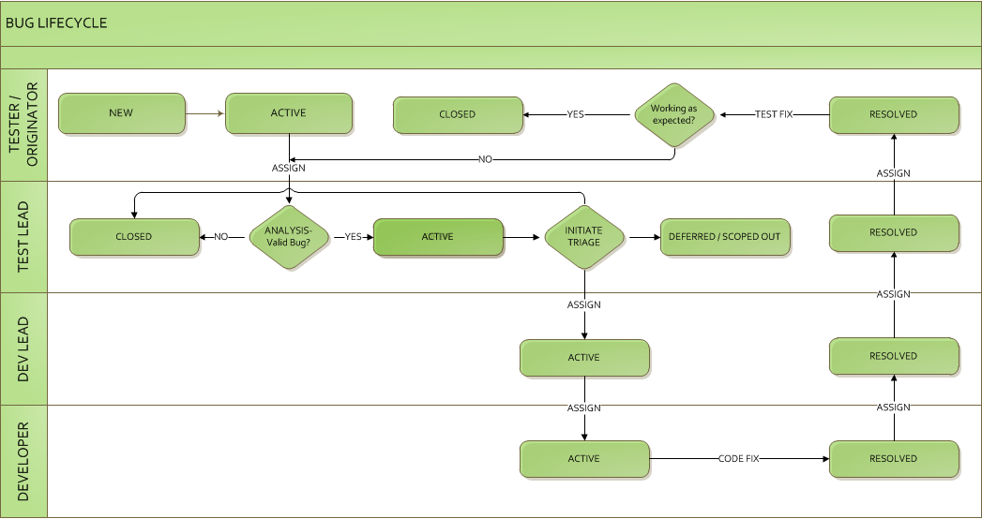
BUG reporting & triaging
Bug Fix
Cross check TFS/JIRA for known issues to avoid duplicate bugs.
Failed test case should be linked to User Story.
Create Link from US to test case in HP ALM.
Prioritize defect to keep in sprint or project backlog.

Slide 20
Glossary
Acceptance Criteria
Application
Director Area
Project
Sprint
Sprint Velocity
Stack Ranking
Story Points
Test Approach
Test Case
Test Plan
Test Scenario
Test Strategy
Traceability Matrix
User Story

